Slide 1

FY25 Budget Approval Meeting

Slide 2
Norms
This is a meeting of the GO Team. Only members of the team may participate in the discussion. Any members of the public present are here to quietly observe.
We will follow the agenda as noticed to the public and stay on task.
We invite and welcome contributions of every member and listen to each other.
We will respect all ideas and assume good intentions.

Slide 3
Agenda
Action Items (add items as needed)
  Approval of Agenda
  Approval of Previous Minutes
  Budget Approval (after final presentation/review and discussion)
Discussion Items (add items as needed)
  Presentation of the final budget
  Security Grant Survey
Information Items (add items as needed)
  Principal’s Report
Announcements
  Complete EOY GO Team Surveys

Slide 4

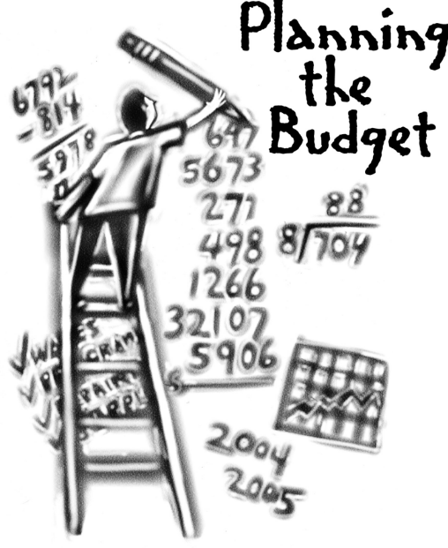
Overview of FY ‘25 GO Team Budget Process
Step 1 Review and Update Strategic Plan and Rank Strategic Priorities
By end of Fall Semester
Step 6 Principals: HR Staffing Conferences Begin
Late February – Early March
Step 3 GO Team Initial Budget Session: Allocation
January 17– early February
Step 7 GO Team Final Budget Approval Meeting
Budgets Approved by March 15
Step 5
GO Team Feedback Session: Draft Budget Presented & Discussed
February – multiple meetings, if necessary
Step 4 Principals: Associate Supt. Discussions and Review
February (supports needed, specific challenges, coaching)
Step 2 Principals: Workshop FY 25 Budget
January 17, 2024
GO Teams are encouraged to have ongoing conversations throughout the year about the school’s budget.

Slide 5
Budget Approval Meeting
What
During this meeting GO Teams will review the budget, which should be updated based on feedback from the staffing conference, Associate Superintendents, and key leaders. After review, GO Teams will need to take action (i.e., vote) on the FY25 Budget.
Why
Principals will present the final budget recommendations for GO Team approval.
When
All approval meetings must be held after staffing conferences. Budgets must be approved by March 15th.

Slide 6
Budget Review

Slide 7
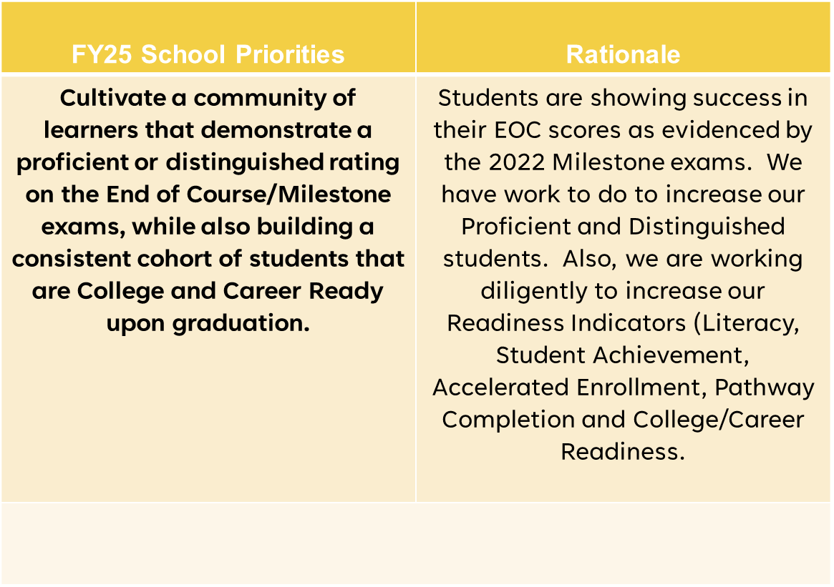

FY25 Budget Parameters
Notes:
Review the priorities that the GO Team has developed and the rationale for these priorities. Feel free to copy this slide if you have more than 3 priorities to account for.

Slide 8
Descriptions of Strategic Plan
Breakout Categories
Priorities: FY25 funding priorities from the school’s strategic plan, ranked by the order of importance.
APS Five Focus Area: What part of the APS Five is the priority aligned to?
Strategies: Lays out specific objectives for school’s improvement.
Request: “The Ask” What needs to be funded in order to support the strategy?
Amount: What is the cost associated with the Request?

Slide 9
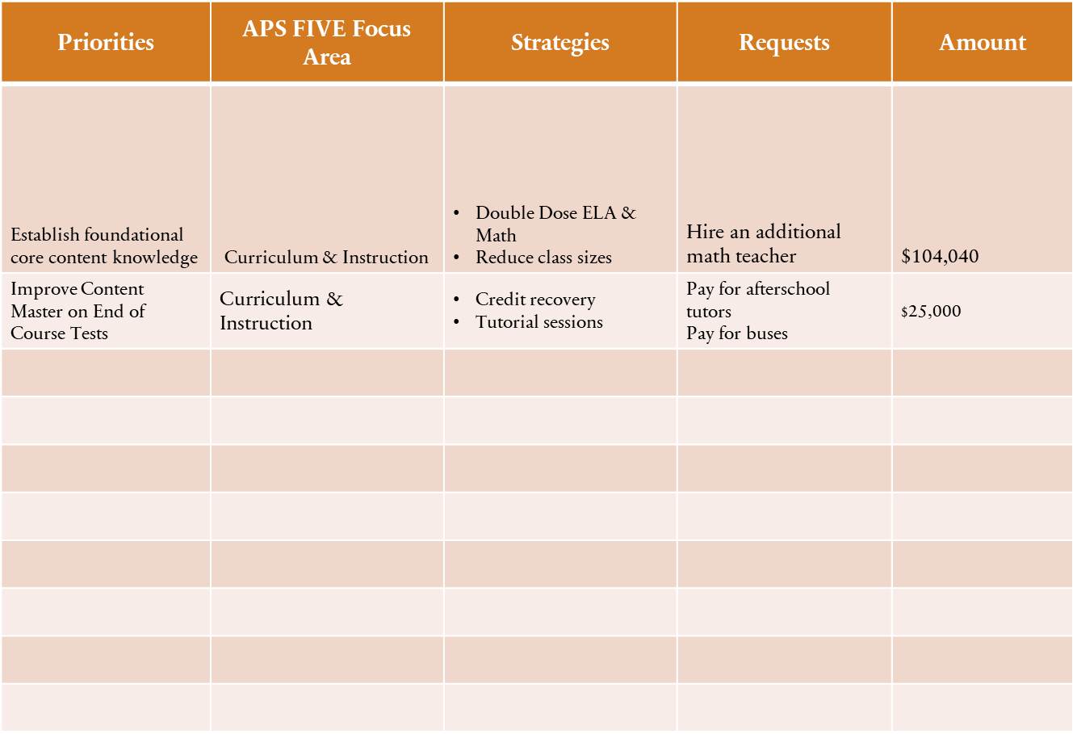
FY25 Strategic Plan Break-out
Notes:
For the next few slides, I will show you how I have allocated the budget to support our strategic priorities.
Based on our strategic priorities and funds we received, here is a break-out of the priorities, which focus area it addresses, the strategies that will be implemented, the purchase request, which funding source was used and the amount.

Slide 10
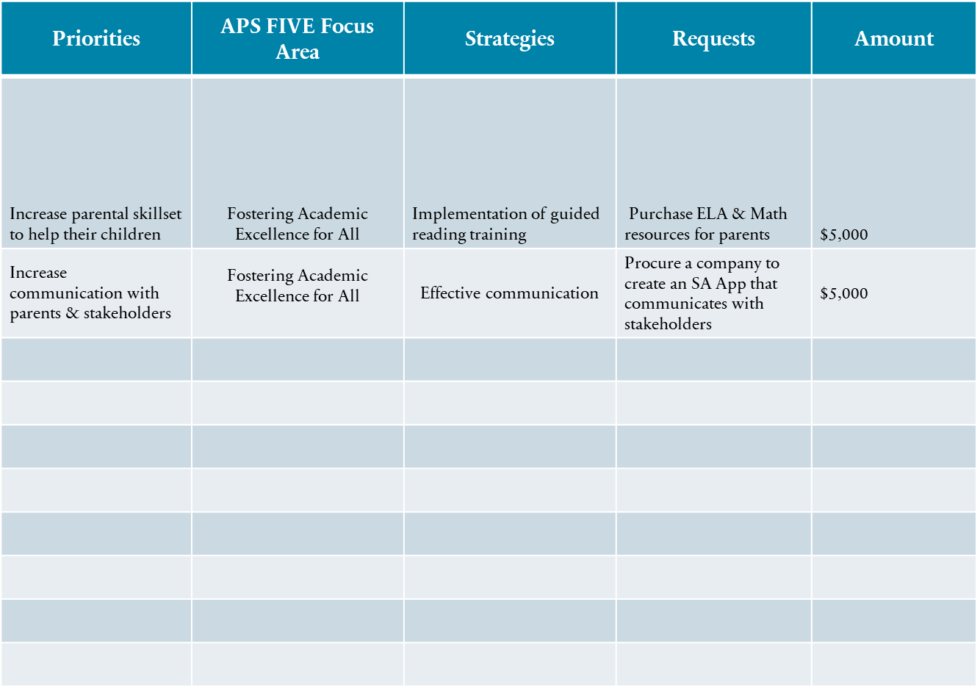
Plan for FY25 Title I Family Engagement Funds
$24,720.00
Notes:
For the next few slides, I will show you how I have allocated the budget to support our strategic priorities.
Based on our strategic priorities and funds we received, here is a break-out of the priorities, which focus area it addresses, the strategies that will be implemented, the purchase request, which funding source was used and the amount.

Slide 11
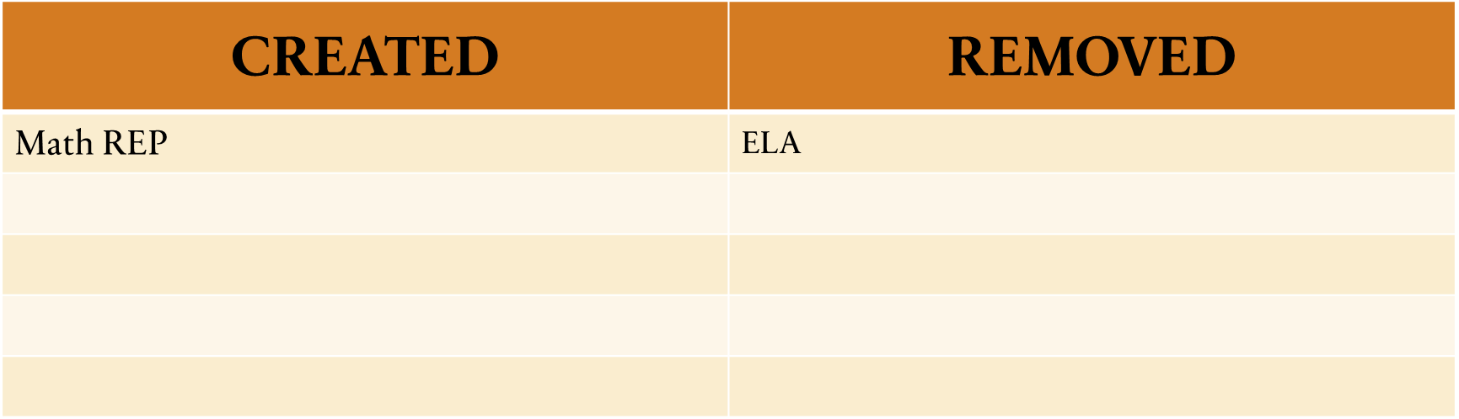
Summary of position Changes to Support the Strategic Plan
Summary of Changes
PRINCIPALS: Please provide a summary of the impact these changes and how it relates to your strategic plan here.

Slide 12

Staffing Conference Changes
Principals –indicate on this slide if there were any changes made to your budget proposal at your staffing conference. If there were no changes, please just cover the Budget by Function on slides 7 & 8 as a quick summary for your GO Team. If there were changes, please summarize for your team and then discuss the NEW Budget by Function values.
There were not any changes made to the draft budget we discussed at our last meeting.

Slide 13
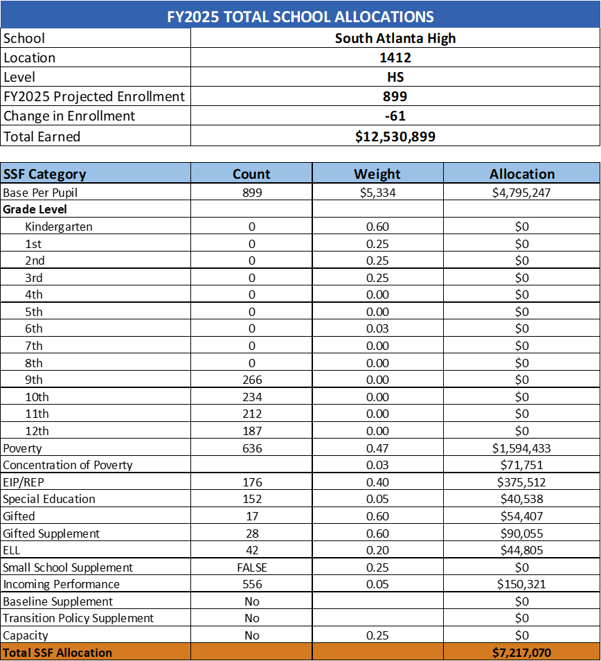
Budget by Function (Required)
*Based on Current Allocation of School Budget

Slide 14
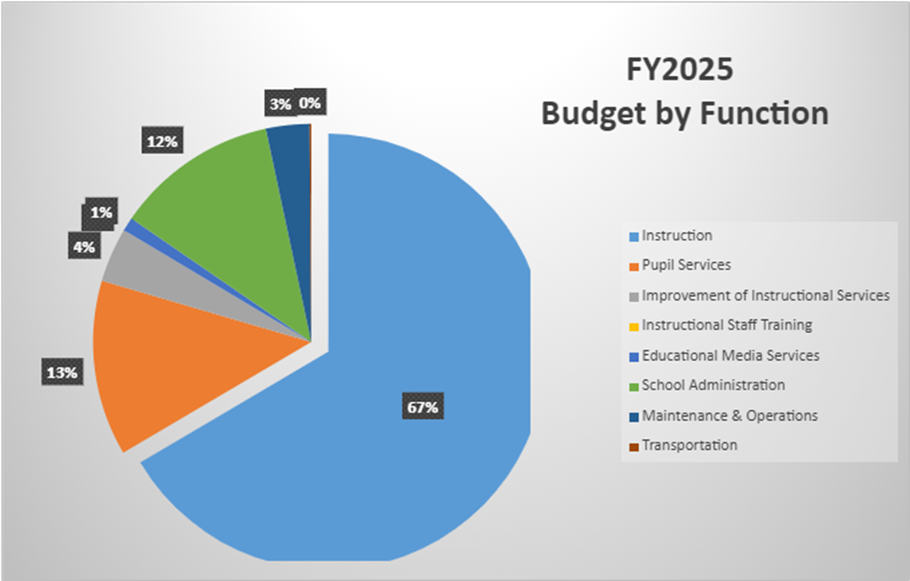
Budget by Function (Required)
*Based on Current Allocation of School Budget

Slide 15
Questions for the GO Team to Consider and Discuss
Are our school’s priorities (from your strategic plan) reflected in this budget?
Are new positions and/or resources included in the budget to address our major priorities?
Do we know (as a team) the plan to support implementation of these priorities beyond the budget (ex. What strategies will be implemented)?
What tradeoffs are being made in order to support these priorities?
How are district and cluster priorities reflected in our budget?
Cluster priorities- what staff, materials, etc. are dedicated to supporting our cluster’s priorities?
Signature programs- what staff, materials, etc. are dedicated to supporting our signature program?
Are there positions our school will share with another school, e.g. nurse, counselor?
Notes:
CHAIR - Our final task for today! Here are questions that we need to consider to ensure we have a good working draft budget. Let’s walk through them together.

Slide 16

Questions?

Slide 17
The GO Team needs to TAKE ACTION (vote) on the presented budget. After the motion and a second, the GO Team may have additional discussion. Once discussion is concluded, the GO Team will vote.
Action on the Budget

Slide 18

Security Grant
Survey

Slide 19
Annoucements

Slide 20
Provide Your Feedback on the Final APS Student Calendar Survey
Atlanta Public Schools has used widespread community engagement to create two calendar options for the following school years: SY 25-26, SY 26-27, and SY 27-28.
Your feedback through this survey is valuable and will be another important piece of information that the Superintendent and the APS School Board of Education will use to make a final decision about our future school calendars.
HOW: Scan the QR code or click the link for a quick survey.
WHO: All stakeholders, including students, staff, families,
and community members.
WHEN: Open from Mon, February 19th to Fri, March 15th
https://survey.co1.qualtrics.com/jfe/form/SV_0VrymDxIIaygE9E
To learn more about the APS Student Calendar development process, visit https://www.atlantapublicschools.us/Page/71713

Slide 21
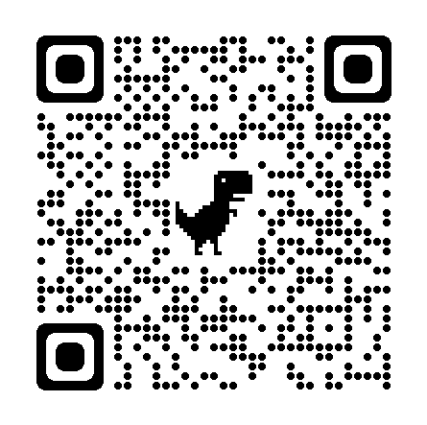
Comparta su opinión en la encuesta final del Calendario Escolar de APS
Basándose en la participación de la comunidad en general, Atlanta Public Schools ha elaborado dos opciones de calendario para los próximos años escolares: 2025-2026, 2026-2027 y 2027-2028.
Su opinión en esta encuesta cuenta y será un factor más que la Superintendente y la Junta de Educación de APS considerarán al momento de tomar la decisión final sobre los calendarios escolares futuros.
CÓMO: Escanee el Código QR o haga clic en el enlace para completar una breve
encuesta.
QUIÉN: Todas las partes interesadas, incluidos alumnos, personal escolar,
familias y miembros de la comunidad.
CUÁNDO: abierta desde el lunes 19 de febrero hasta el viernes
15 de marzo
https://survey.co1.qualtrics.com/jfe/form/SV_cAqsxuT3U5nNu0m?Q_lang=ES
Para más información sobre el proceso de desarrollo del Calendario Escolar para Estudiantes de APS, visite: https://www.atlantapublicschools.us/Page/71713

Slide 22
GO Team members remember to:
  Complete your required trainings
    Orientation
    Ethics
    Budget
  Complete the end of year surveys (check your email for the links)
    GO Team Self-Assessment
    Principal Feedback

Slide 23
Questions?

Slide 24

Thank you

